Slide 1
Maximizing Code Coverage with Genetic Algorithms
By: Casey Jackson

Slide 2
Motivation
Maximizing Code Coverage is Essential for any Testing Suite
Creating Automated Tools for Obtaining Maximum Code Coverage are Highly Needed
Especially true in Black-Box Testing, where the tester has no knowledge of the codebase, and can only view inputs and output responses
This project aims to create an automated tool for generating tests that achieve maximum code coverage across a variety of functions using a genetic algorithm.

Slide 3
Existing Research
Code Coverage Optimisation in Genetic Algorithms and Particle Swarm Optimisation for Automatic Software Test Data Generation – Chahine Koleejan, Bing Xue, and Mengjie Zhang: https://homepages.ecs.vuw.ac.nz/~xuebing/Papers/GAPSOtestDatacec2015.pdf
Genetic algorithm in code coverage guided fuzz testing – Jääskelä, Esa: https://oulurepo.oulu.fi/handle/10024/6947
YAACT: A genetic algorithm tool for code coverage analysis – Victor Rodriguez Jindrizka Dominguez Gilberto Sanchez: https://www.overleaf.com/articles/yaact-a-genetic-algorithm-tool-for-code-coverage-analysis/ztfwqdrsbvfs.pdf

Slide 4
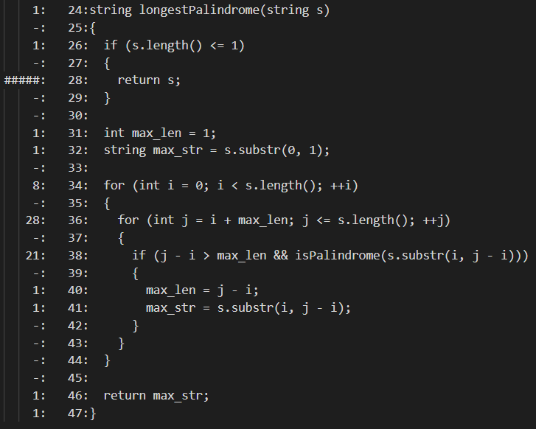
Code Coverage Tools – Coverage Gutters
Code Extension
Generates .gcov File that contains Code Coverage Info
Must be Parsed and Read into Algorithm to see Current Code Coverage

Slide 5
Genetic Algorithm – Basic Steps
Initialize a random population of inputs
Assign each input a fitness score depending on its performance in the function
In this case, fitness is based on code coverage
Select a subset of the population based on fitness to become parents
Usually half
Perform crossover and mutation to produce a set of children
Combine children with parents to for a new population
Repeat

Slide 6
Implementation – Pre-Conditions
User can add a function to the codebase
Current version only works with string arguments
User specifies the maximum number of generations they want to run and the population size per generation
User can also specify if they want the program to stop if 100% coverage is reached or just all branches are executed at least once
User then runs the main program to generate test inputs with the genetic algorithm
Program stops once 100% code coverage is achieved, or maximum generation is reached

Slide 7
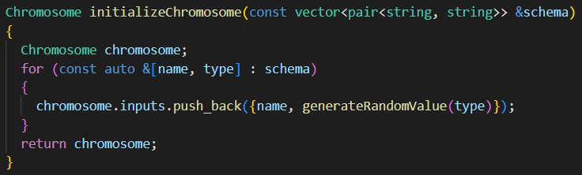
Implementation – Initialization
Initialize Population
Generate Chromosomes with Random String Values

Slide 8
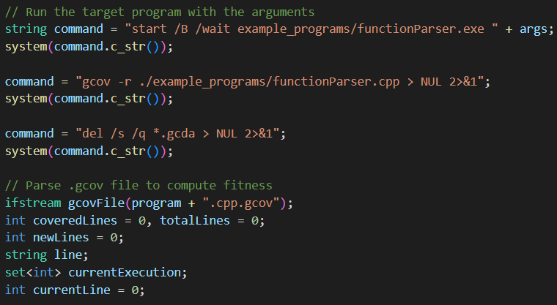
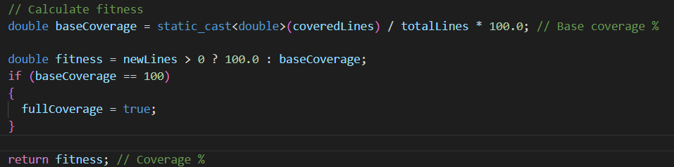
Implementation – Fitness Evaluation
Run the specified function on each test case
Calculate fitness value based on:
Percentage of statements run
Statements run for the first time get higher fitness value

Slide 9
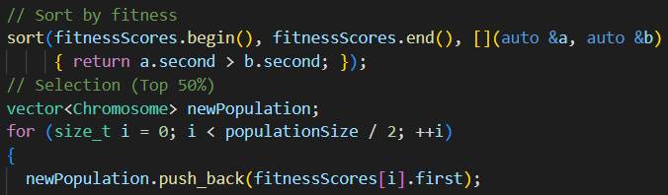
Implementation – Test Case Selection
Select Tests Based on Certain Criteria
Possible Test Selection Methods:
Tournament Based
Rank Based

Slide 10
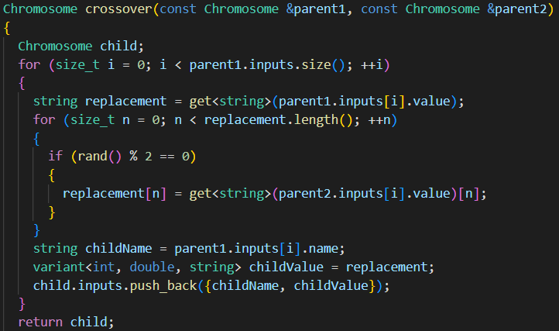
Implementation – Crossover
Select two parents
Combine parts of their test output to create children
Slightly different behavior between pure numbers and strings

Slide 11
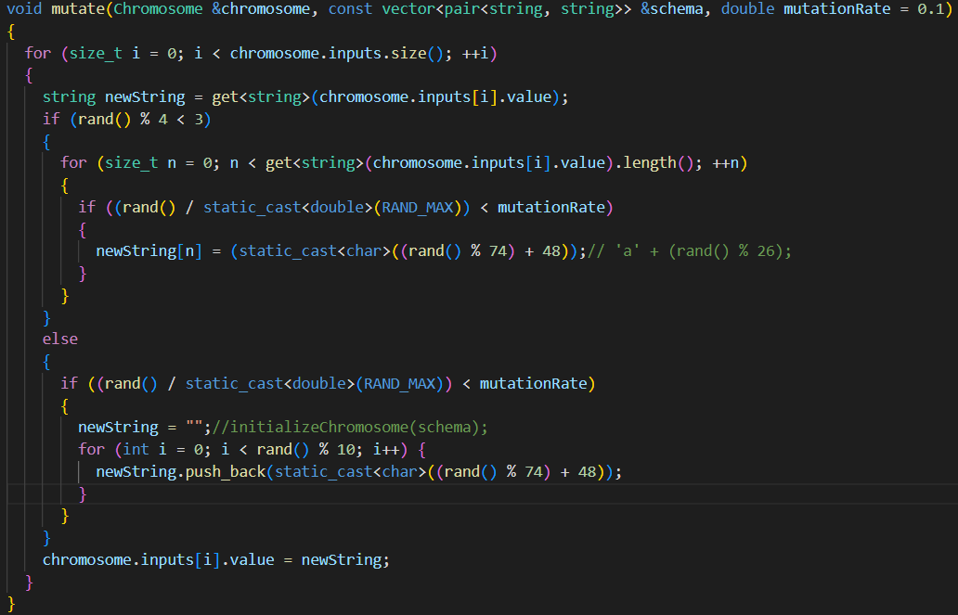
Implementation – Mutation
Randomly Change the Value of a Variable
Mutation Rate can be changed Depending on User Needs
Introduces Diversity and Prevents Stagnation
Possible to Dynamically Change Mutation Rate
Once Again, Slight Difference for Strings

Slide 12
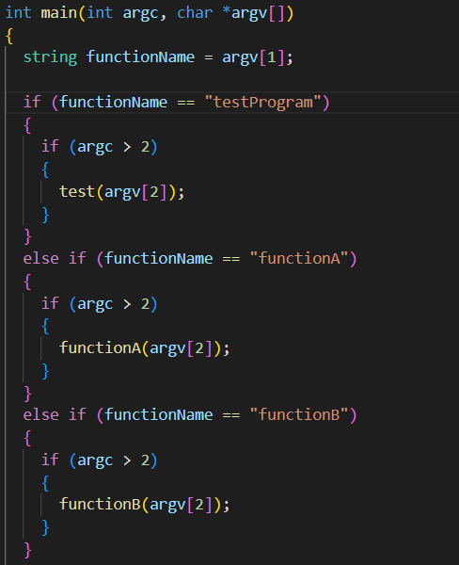
Implementation – Function Parser
Used to organize included test functions
When call is made from generic algorithm, this function translates arguments into inputs for function call
Currently, very simple. Can be made much more complex in the future to cover a wider variety of inputs

Slide 13
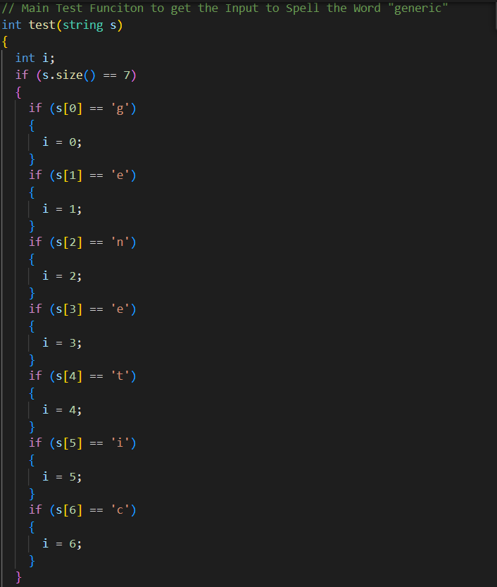
Evaluation – Test Program
Input: Any String
Goal: Achieve 100% Statement Coverage by Spelling out the Word “generic”
Useful test to see how the genetic algorithm can slowly build a test case to achieve full code coverage

Slide 14
Demo – Test Program
General Observations:
Takes anywhere between 30 – 100 Generations to Complete
Last Character takes Longest
User Preferences May Be Different

Slide 15
Evaluation – Other Programs
A few other basic string functions were tested against this algorithm:
Function | Avg. Code Coverage
Test Program | 95%
Function A | 65%
Function B | 100%
Function C | 95%
Function D | 83%
Function E | 100%
Function F | 100%
Function G | 100%

Slide 16
Future Work
Genetic Algorithm can take a wider variety of functions with various input types
Refine various features (selection, crossover, mutation)
Evaluate branch coverage alongside statement coverage
Give user the option to specify test selection method
Make easier to implement for users, provide them with a more detailed report when execution is finished
Test on a wider variety of programs

Slide 17
Conclusion
Genetic Algorithms, when implemented correctly, contain a variety of uses, not just for achieving code coverage
Because of the variety of different kinds of genetic algorithm implementations that exist, more work will need to be done to create an algorithm with a wider variety of options for user needs
A fully functional genetic algorithm has the potential to provide programmers with the perfect tool for generating test cases that maximize their code coverage

